Slide 1
Sentiment Analysis in R
Jenn Schilling
October 20, 2021
Notes:
Your notes here

Slide 2

Hello!
Jenn Schilling
she/her/hers
Senior Data Analyst, University Analytics & Institutional Research, University of Arizona
Adjunct Faculty, College for Creative Studies
Notes:
Welcome to Day 1 of the Sentiment Analysis in R webinar. I’m Jenn Schilling, my pronouns are she/her/hers, and I am so happy you’re here. I am a senior data analyst at the University of Arizona, and an adjunct faculty member at the College for Creative Studies where I teach graduate classes on data visualization. Thank you for being here, and I hope you will find this webinar beneficial. Before I begin, I would like acknowledge that I am on the ancestral lands of the Tohono O'odham and Pascua Yaqui nations, indigenous peoples who have occupied this land since time immemorial.
Territory acknowledgements are one small part of disrupting and dismantling colonial structures.

Slide 3
Learning Outcomes
Prepare data for a text analysis in R
Conduct text mining in R
Complete sentiment analysis in R
Notes:
The learning outcomes of this webinar are that participants will be able to prepare data for a text analysis, conduct text mining, and complete a sentiment analysis in R.

Slide 4
Day 1 Agenda
Introduction to Text & Sentiment Analysis
R Set-Up
Data Processing
Tokenizing
Word Frequencies
Questions
Notes:
This webinar will teach participants how to complete a text analysis in R, including data processing and cleaning, visualization of word frequencies, and sentiment analysis. Sentiment analysis is useful for finding patterns in text data from open response questions on surveys and course evaluations as well as evaluating social media posts.
Today we will go over…

Slide 5
What is text analysis?
Notes:
Text analysis is the processing and analyzing of text data. We frequently encounter text data in higher education through course descriptions, student feedback on surveys or course evaluations, and social media posts. Text analysis allows us to analyze that data to determine word frequencies, common themes, and patterns.
One challenge with text analysis is that words can have multiple meanings depending on context and interpretation. Text analysis and sentiment analysis do not pick up on sarcasm, tone, or context. However, they can be useful to find broad commonalities and overarching themes.

Slide 6
What is sentiment analysis?
Notes:
A component of text analysis is sentiment analysis which aims to determine the sentiment of a piece of text – is it positive or negative? Does it invoke joy or sadness? There are a few different dictionaries of word sentiments that can be used to determine the feeling behind a piece of text. Again, the sentiment can sometimes be off due to context, sarcasm, etc. but it can be a useful analysis for approximating the broad feelings behind text.

Slide 7
Why is it useful?
Notes:
Text and sentiment analysis are useful for analyzing large quantities of text automatically. They can help us find general themes and feelings, and they allow us to quite quickly analyze text data that could take a long time to process by hand. Applications to institutional research include analyzing course evaluations, student, faculty, or staff responses to surveys, and social media content. In the example we will walk through in this webinar, I will be analyzing tweets that use the University of Arizona hashtag.

Slide 8
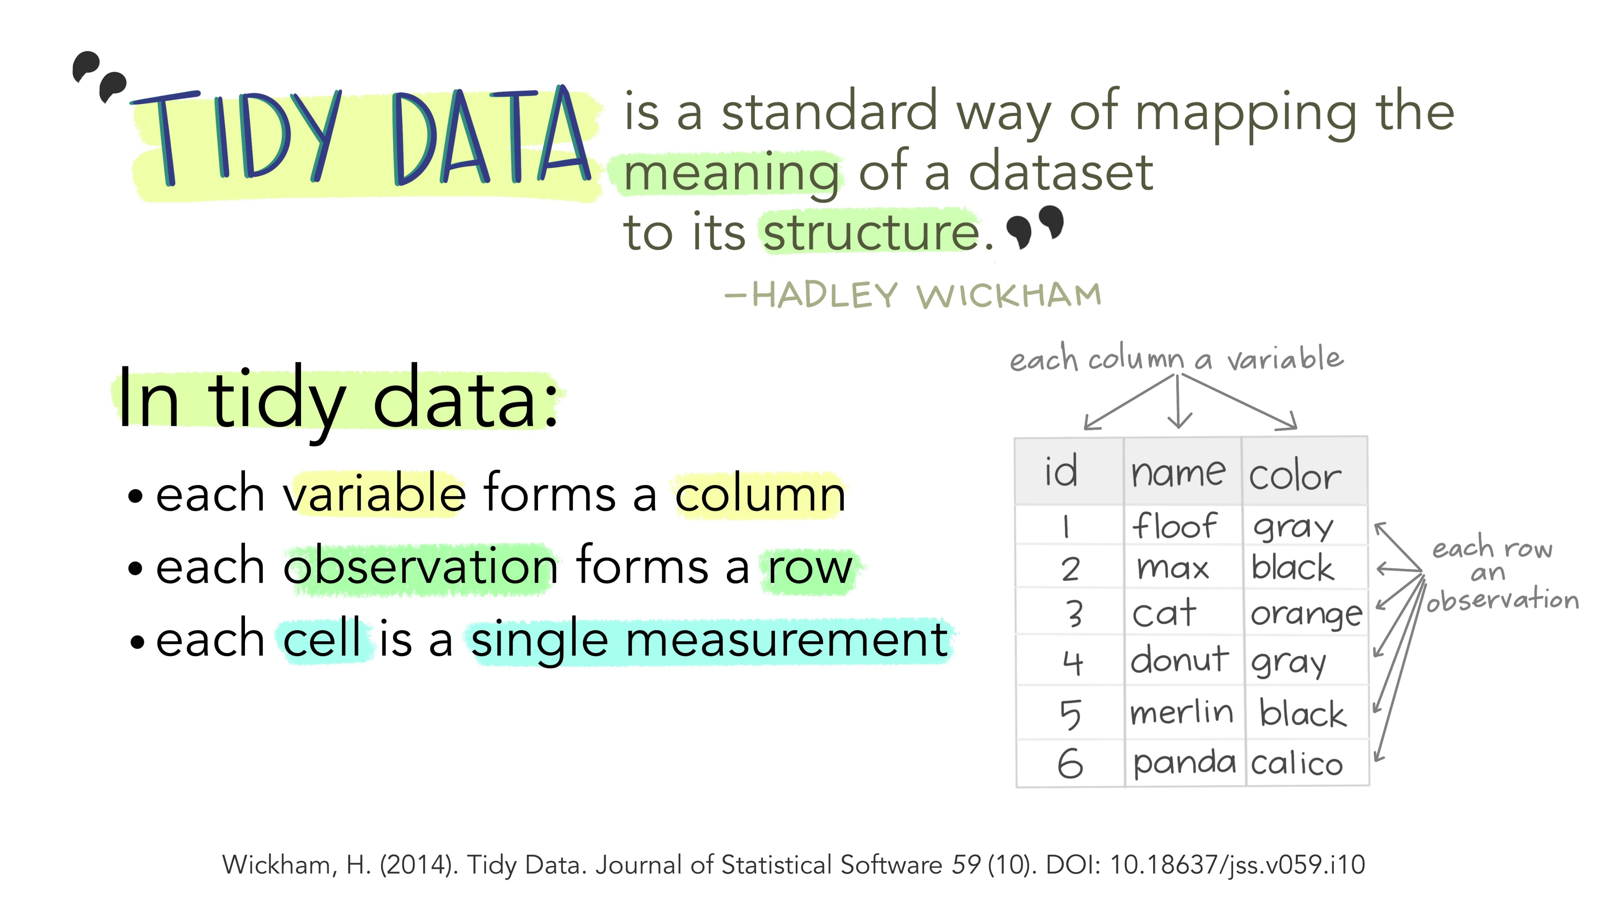
Illustrations from the Openscapes blog Tidy Data for reproducibility, efficiency, and collaboration by Julia Lowndes and Allison Horst
Notes:
Before we get started in R, I would like to define tidy data. Tidy data is a structure of data in which each variable is a column, each observation is a row, and each cell is a single measurement. For text analysis, we can create a tidy text data table or data frame which contains one token per row. A token is a meaningful unit of text, such as a word. The first step in text analysis is called tokenizing, which involves splitting a long text string, such as a tweet, document, or open-ended responses, into individual words or sets of words.

Slide 9
R Setup
General Setup
R Markdown
tidyverse package
tidytext package
Text data
Webinar Materials
code
data-viz-in-r-code.Rmd
data
ipeds_2017
ipeds_2018
ipeds_2019
ipeds_dict
plots
.here
README.txt
Notes:
To get set up in R, all you will need is the tidyverse and tidytext packages installed and a set of text data.
R Markdown is a very useful tool/file format that can be used to create documentation along with your code. This is ideal for reproducibility.
The webinar materials provided include an R Markdown file with all the code to process the data and create the plots used in this webinar, the data files used, which I will discuss in a little more detail soon, and a folder for plots. The .here file is needed so that the R Markdown code knows where to find the data files and save the plot. The README file contains more information about each individual file and the structure of the folder.

Slide 10
What did we learn today?

Slide 11
Questions

Slide 12
Sentiment Analysis in R
Jenn Schilling
October 22, 2021
Notes:
Your notes here

Slide 13
Learning Outcomes
Prepare data for a text analysis in R
Conduct text mining in R
Complete sentiment analysis in R
Notes:
The learning outcomes of this webinar are that participants will be able to prepare data for a text analysis, conduct text mining, and complete a sentiment analysis in R.

Slide 14
Day 2 Agenda
Recap of previous session
Sentiment Analysis
Visualizing Results
Moving Beyond Words
Where to go from here
Questions
Notes:
Welcome back to Day 2 of the Sentiment Analysis in R webinar. I’m so happy you’re here.
This webinar will teach participants how to complete a text analysis in R, including data processing and cleaning, visualization of word frequencies, and sentiment analysis. Sentiment analysis is useful for finding patterns in text data from open response questions on surveys and course evaluations as well as evaluating social media posts.
Here’s today’s agenda…

Slide 15
Quick Recap

Slide 16
What insights can be gained from text and sentiment analysis?

Slide 17
Where to go next
Experiment with the provided code and data sources.
Some Resources:

Slide 18
What did we learn today?

Slide 19
Questions

Slide 20
References

